Slide 1
Ordering Pictures Yearbook
Before Picture Day:
Option 1: Bring in your picture order form and money on Monday or Tuesday and hand it over at picture-taking time.
Option 2: Go to
https://hrimaging.com/#shop
And click on the yellow circle (prepay for pictures before picture day).

Slide 2
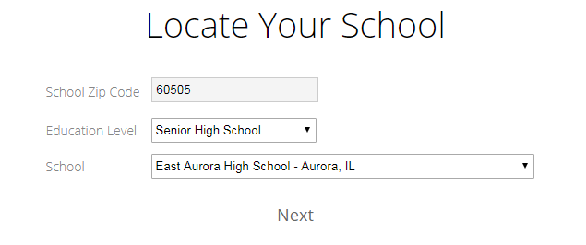
Fill out the below drop-down menu

Slide 3
Ordering Pictures Yearbook
The students will then be asked to select
- the day they will take the picture (12/4 or 12/5)
- Type his or her first and last name

Slide 4
Ordering Pictures Yearbook
To order after picture day, click on “need help signing in” (because the student will not have their “subject number”- a number which keeps the students’ numbers safe) and the process will begin again.

